Slide 1
Raspberry Pi
Diversions

Slide 2
Raspberry Pi
crappy
As a motion detection video recorder
An experiment

Slide 3
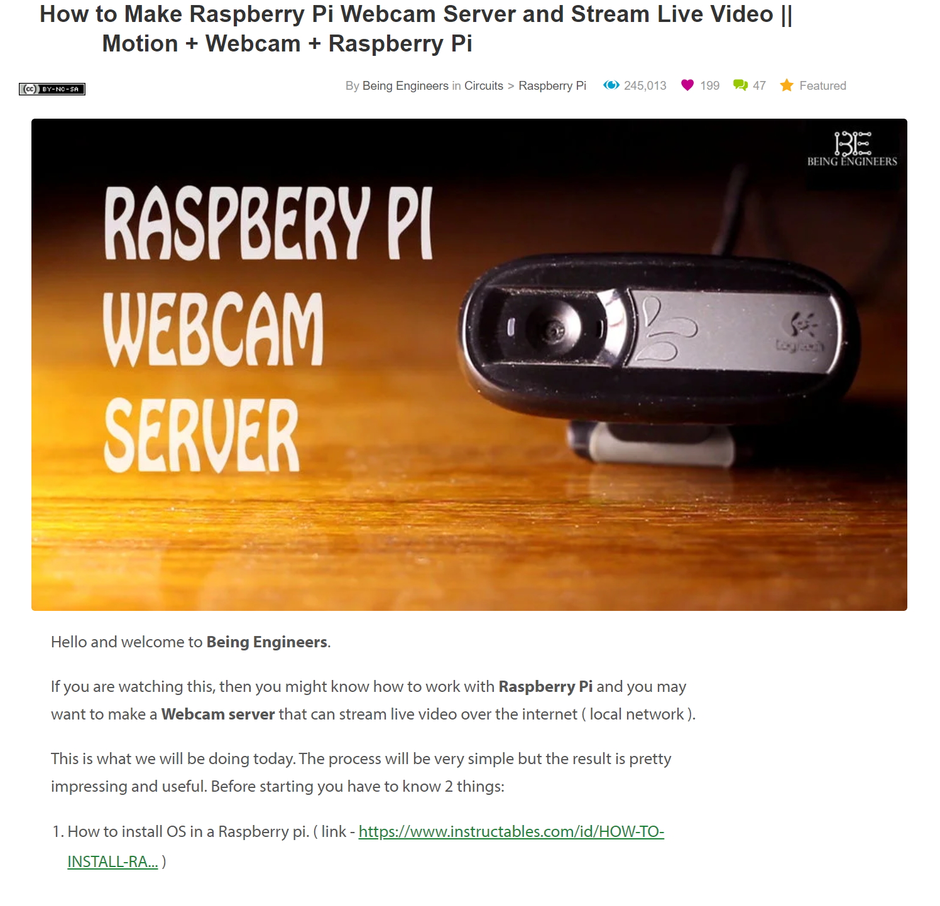
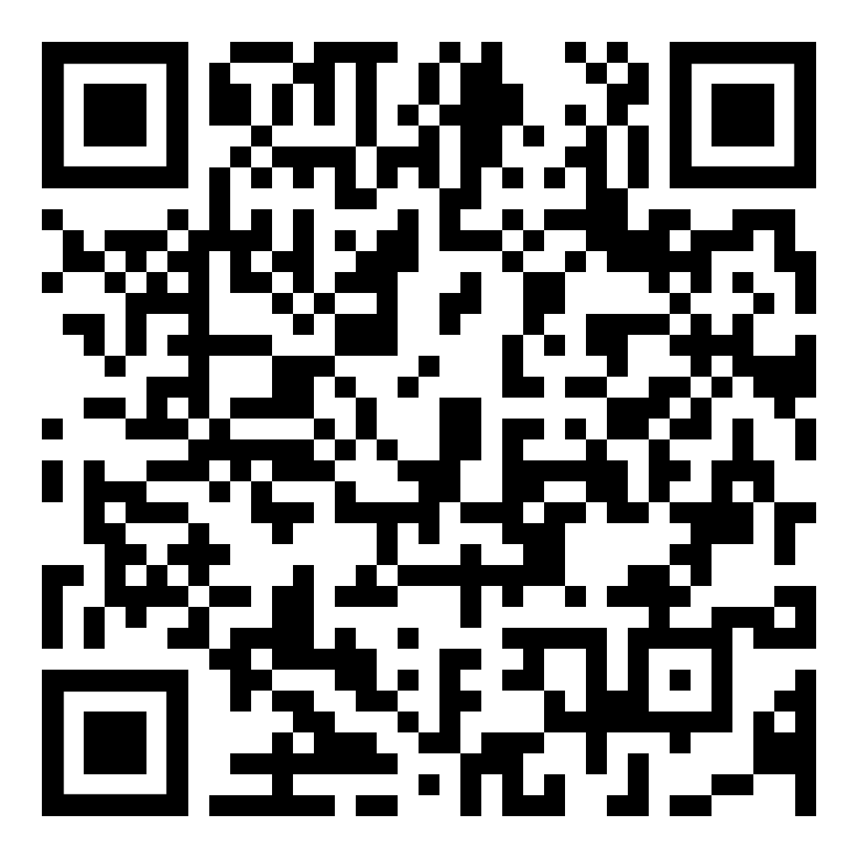
Then an instructables page caught my eye:
https://www.instructables.com/id/How-to-Make-Raspberry-Pi-Webcam-Server-and-Stream-/

Slide 4
I have a PI and a budget USB webcam
Wouldn’t be handy to keep an eye on the pets while we are away for the weekend?
Keep an eye on the back shed,
Be notified when neighbours contractors borrow the hose connection and leave the gate open.

Slide 5
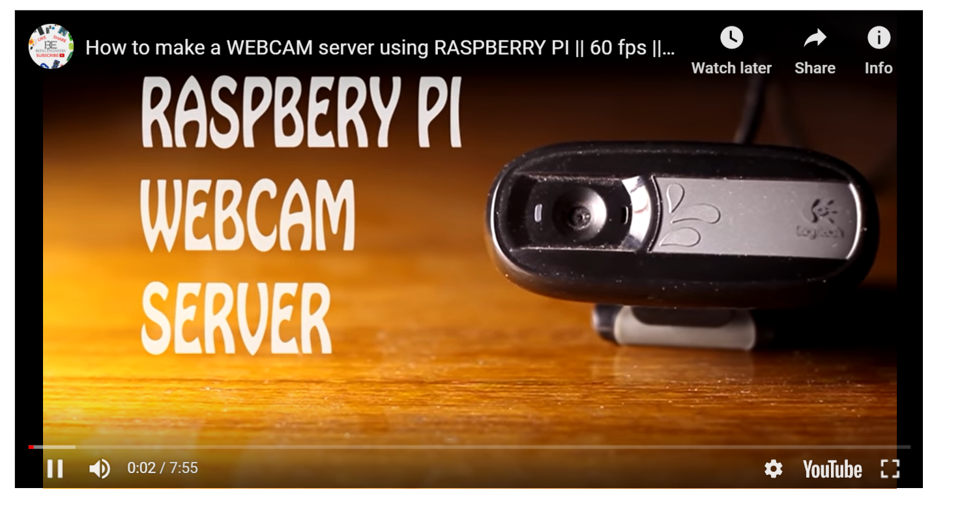

How hard can it be to get started
What??? An 8 min video, it can’t be that hard
to install and run, TL;DR

Slide 6
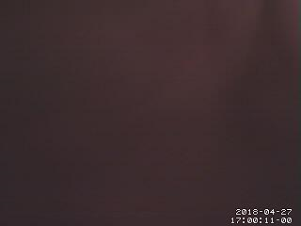
Let’s just install it and see how it goes
“sudo apt-get install motion”
Start the service, open a browser to localhost:8080

Slide 7
Black screen?
OK, waving my hand in front it shows as white.
Great for debugging, but what is IT seeing?
Tried a simpler approach:
(and not just plugging it into a nearby PC, that’s cheating)
$ sudo apt-get install fswebcam
$ sudo apt-get install mplayer
Used fswebcam to capture a still and review,

Slide 8
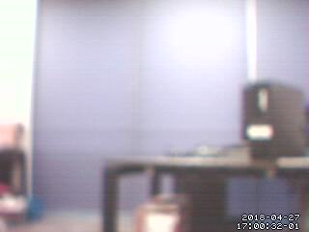
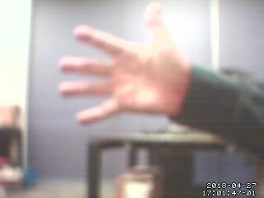
OK, it’s blurry, but ‘working’
Black was setup_mode, now a really blurry live stream ¯\_(ツ)_/¯

Slide 9
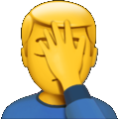
Focus:
Ahh, the webcam is so budget it has manual focus ring
Makes sense for a face to face webcam.
Now it’s late, and the gain is making a mess of the video.
Tried fixing the exposure controls:
auto_brightness off, brightness, contrast, saturation
Better, but really limited as it won’t adapt to normal daylight changes

Slide 10
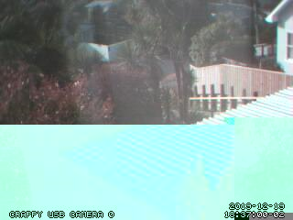
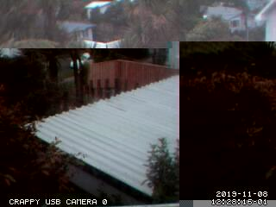
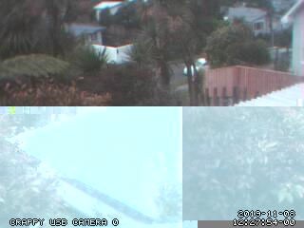
Let it run for a while out the front window:
WTF, the detection area size is huge, but it’s still recording everything
What should I have expected from a DSE rebadge.
Alright, I’ll switch to the Micro$oft one when I can dig it out next.

Slide 11
But it looked like an occasional flash
So what happens if I increase the motion frames limits to compensate
Configuration option: minimum_motion_frames
So the range is 1-1000, and default of ONE?
More reasonable results from a 5 frame setting

Slide 12
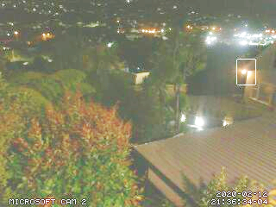
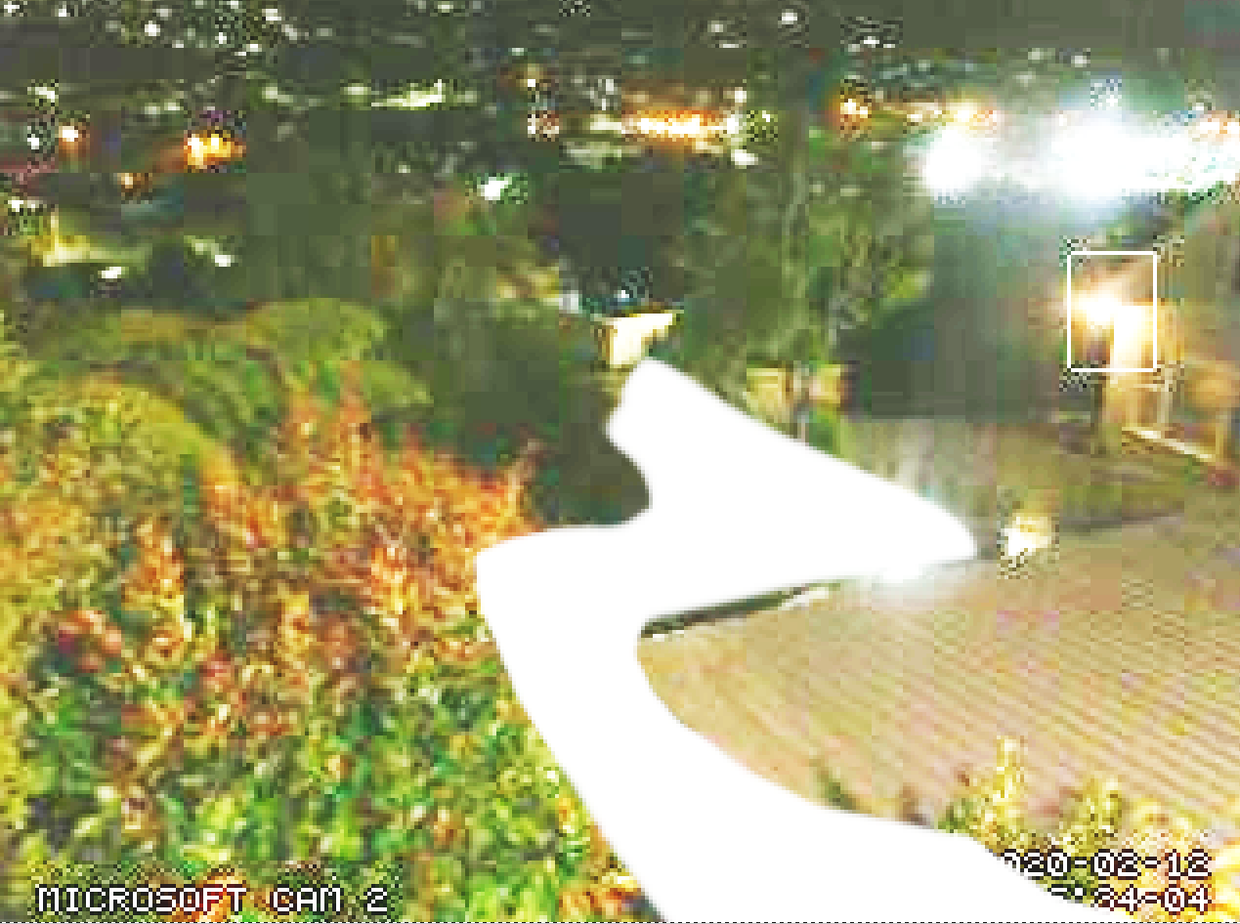

Refining the trigger area
Trigger areas aren’t tricky to set up, they’re just a grayscale mask.
Take a snapshot, black out the chaff (gray for less sensitivity)
Well my front section is the worst scene to pick.
Even the portions without vegetation have shadows, birds, and at the distance trigger when the area size is reduced to the usable amount (aka just big enough)

Slide 13
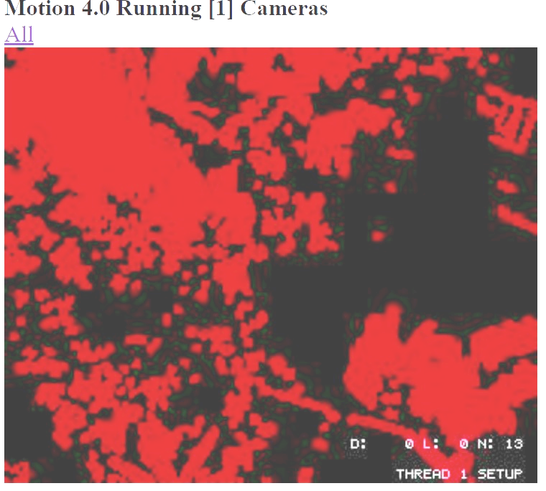
Adaptive detection area: smart_mask_speed
Tried 8 (range is 1 to 10)
Checked after an hour to settle and
setup mode showed these exclusion:
It really shows that the test view isn’t really
practical with that many plants in the shot.

Slide 14
Extensions
Remote admin: stream_localhost off webcontrol_localhost off
Script triggers: on_event_start/end, on_picture_save, on_motion_detected,
on_area_detected, on_movie_start/end, on_camera_lost/found
SMTP + IMAP ( Must have a ‘STOP’ option)
Google Drive/iCloud/Dropbox – Store images and video offsite
PIR detectors, lighting relays
Doorbell/Alarm mode – Alter alerting severity when a resident is detectable.
www.home-assistant.io/

Slide 15
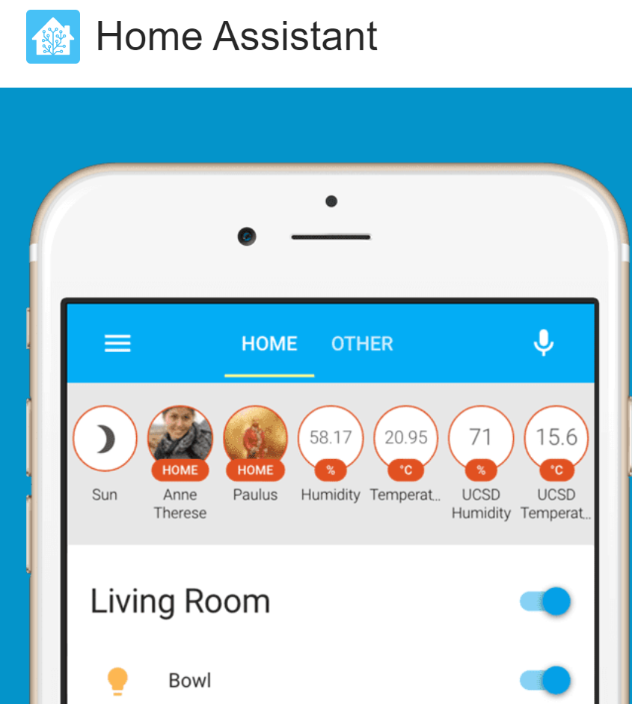
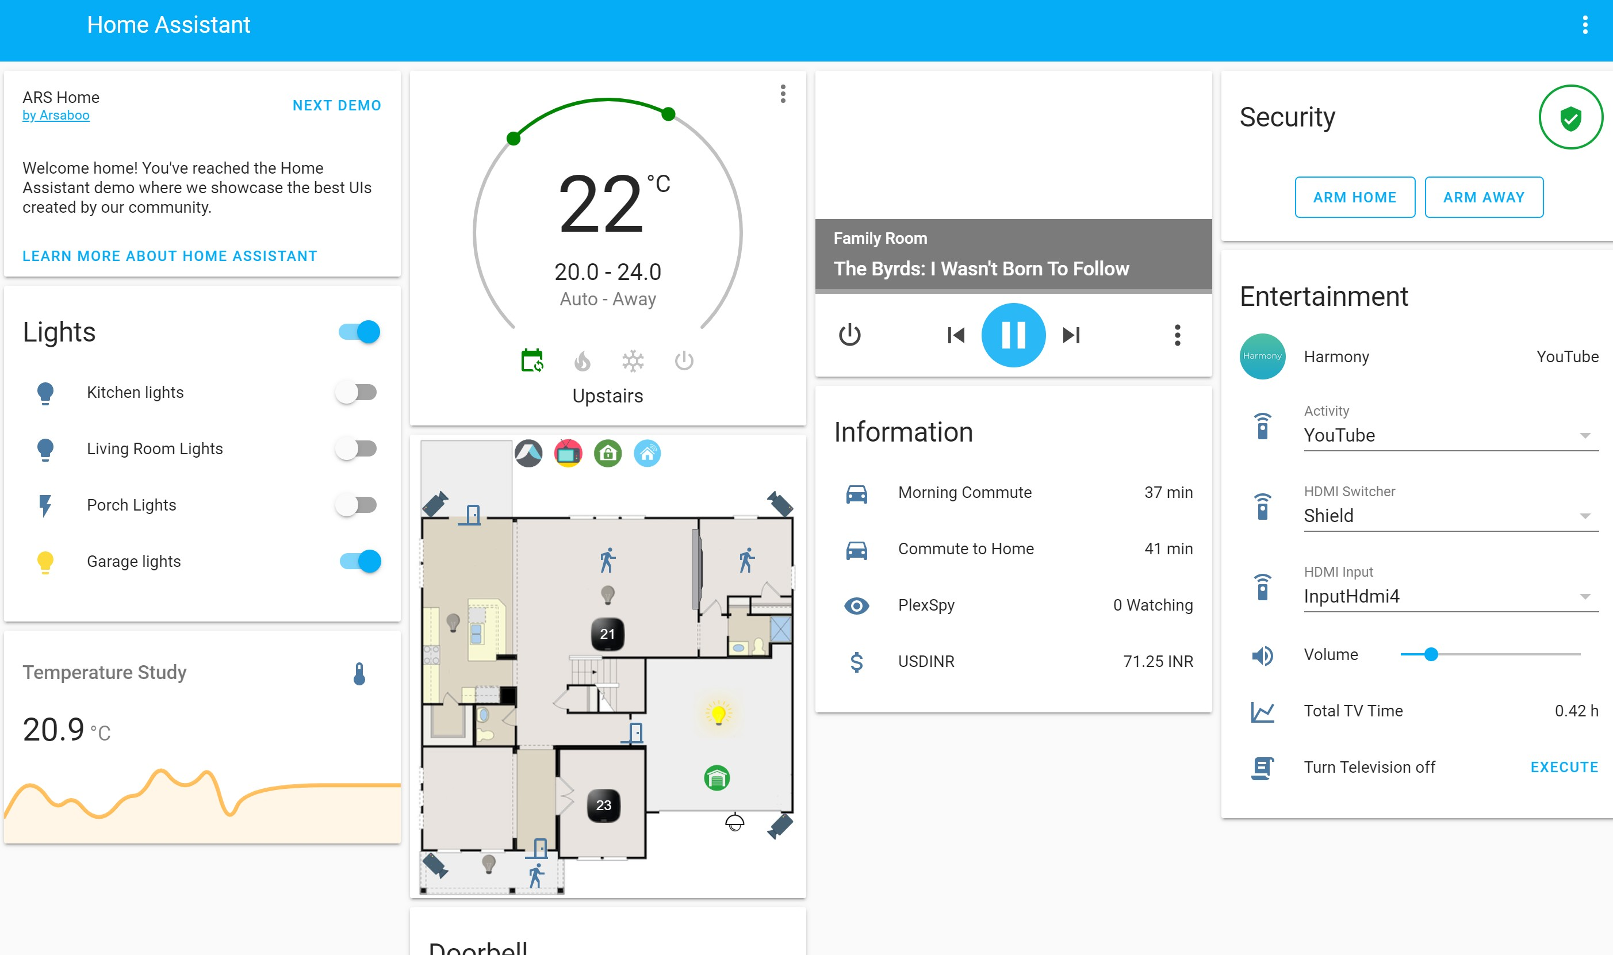
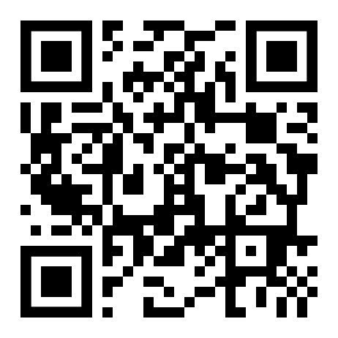
www.home-assistant.io

